Slide 1




Cyber Resume

Slide 2
Cybersecurity First Principles
Domain Separation
Process Isolation
Resource Encapsulation
Least Privilege
Layering
Abstraction
Information Hiding
Modularity
Simplicity of Design
Minimization

Slide 3

http://csrc.nist.gov/nice/NICE_Workforce_Demand.pdf

Slide 4

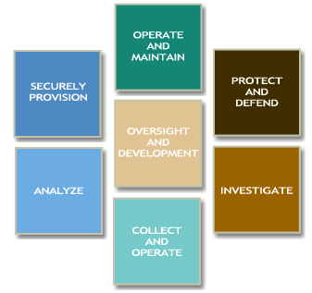
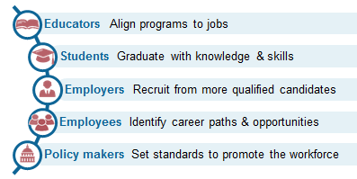
https://niccs.us-cert.gov/training/tc/framework
Notes:
Walk through the website

Slide 5
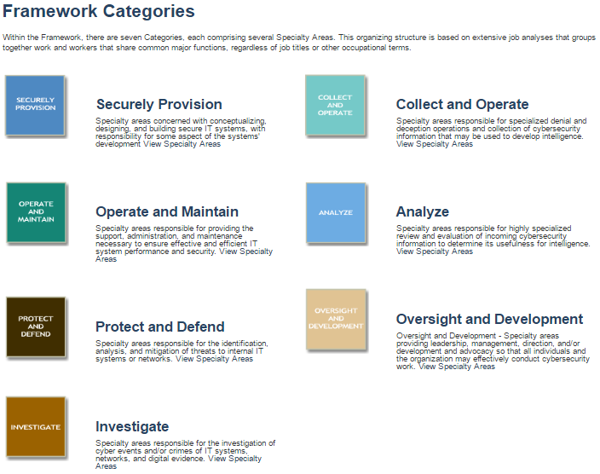
Notes:
Go to the website and discuss the many career options.
https://niccs.us-cert.gov/training/tc/framework/categories

Slide 6
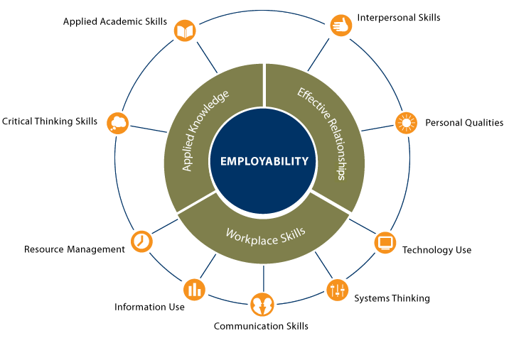
http://cte.ed.gov/employabilityskills/

Slide 7
How to get a job in cybersecurity
Education
Training / Certifications
Security+
SSCP / CISSP
SANS
Experience
CyberPatriot
Work
Volunteer

Slide 8
NICCS Framework Specialty Areas
Use the worksheet to match the job title and description with the student assigned that role.
Notes:
Game matching job title description with the student assigned that role.
Give each student a slip of paper with the role and role description.
Give each student a worksheet with the role and description. They need to write-in other student’s names matching the title. They are not allowed to directly ask “Are you <Job Title>?” Instead they ask questions using the job description.

